Slide 1
PERIMETER SECURITY DEVICE USING ARDUINO WITH IOT

Slide 2
: Team members:
1602-20-735-131 DURGESHWAR REDDY
1602-20-735-152 SAI CHARAN
1602-20-735-165 SRI CHANDANA

Slide 3
CONTENTS:
Introduction
Components
Components Description
Code
Advantages
Future Scope
Conclusion
References

Slide 4
INTRODUCTION:
Perimeter Security Device( PSD) function is to detect intruders and send notifications in the case of a security event.
Through this system an intruder can be detected when, attempting to enter a secured area, and an audible or visual alarm is activated on site while simultaneously sending an alert to device using IOT.
The main purpose of this is to protect from burglary, vandalism, property damage, and, of course, the security of the individuals inside the building.
IOT(Internet of Things) is a physical object whose main purpose is connecting and exchanging data with other devices and systems over the internet.

Slide 5
COMPONENTS
PIR sensors
GSM module
Arduino uno
Breadboard
Connecting wires

Slide 6
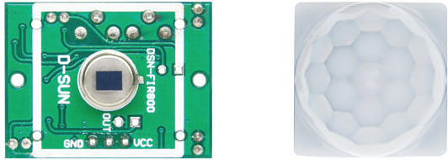
PIR SENSORS
All objects, including the human body, at temperatures above absolute zero (0 Kelvin / -273.15 °C) emit heat energy in the form of infrared radiation. The PIR sensor is specifically designed to detect such levels of infrared radiation.
A PIR sensor consists of two main parts:
pyro electric sensor
Fresnel lens

Slide 7
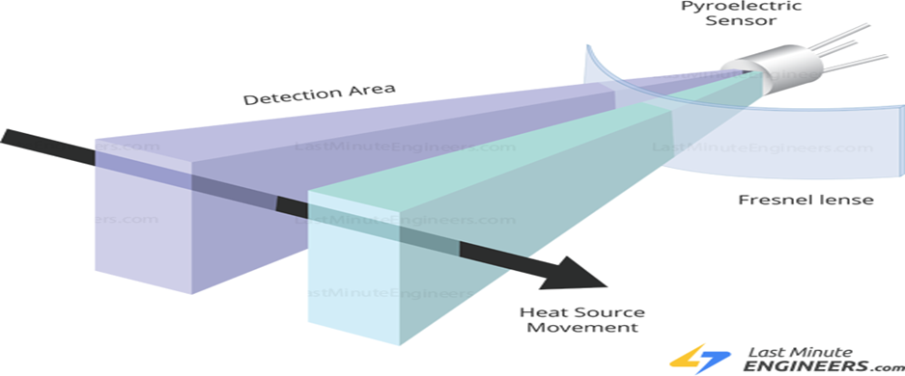
HOW DO PIR SENSOR WORK?
Pyroelectric Sensor:
A pyro electric sensor consists of two rectangular slots that allows infrared radiation to pass through. Two separate infrared sensor electrodes, responsible for producing the positive output negative output.

Slide 8

When NO INTRUDER, around the sensor, both slots detect the same amount of infrared radiation, resulting in a zero output signal.
when an INTRUDER PASSES by, it first intercepts half of the sensor. By reading this change in voltage, motion is detected.

Slide 9
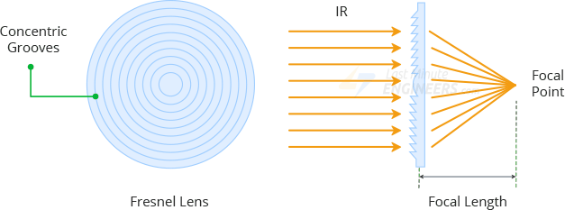
FRESNEL LENS:
It is used to increase the range and field of view of the PIR sensor.

Slide 10
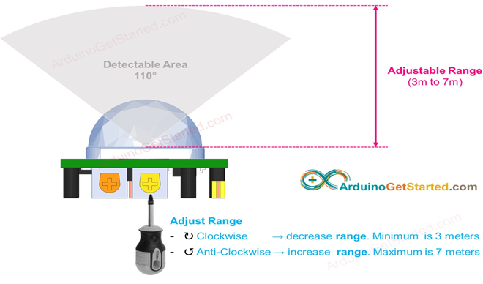
HC-SR501 PIR sensor
WHY HC-SR501 SENSOR?
low power, low cost
easy to interface
power 5V – 12V
Range adjustable
Detectable angle of 110 degrees
High Sensitivity.
The sensor output goes HIGH
when motion is detected and goes
LOW when idle (no motion detected).

Slide 11
GSM MODULE
GSM- Global System For Mobile Communication
Global System for Mobile communication (GSM) module is designed for wireless radiation monitoring through Short Messaging Service (SMS).
This module is able to receive serial data from radiation monitoring devices such as sensors and transmit the data as text SMS to a host .
It provides two-way communication for data transmission.
Microcontroller provides control for sending, receiving and AT command processing to GSM module.

Slide 12
AT COMMANDS
AT commands with a GSM is used to access the SMS services.
Some commonly used AT commands for SMS:
AT This command is used to check communication between the module and the computer.
+CMGS – This command is used to send a SMS message to a phone number.
+CMGW – This command is used to store message in the SIM.
ATD – This command is used to dial or call a number.
+CMGF – This command is used to set the SMS mode. Either text or PDU mode can be selected by assigning 1 or 0 in the command.
+CMSS- This command sends message from storage

Slide 13
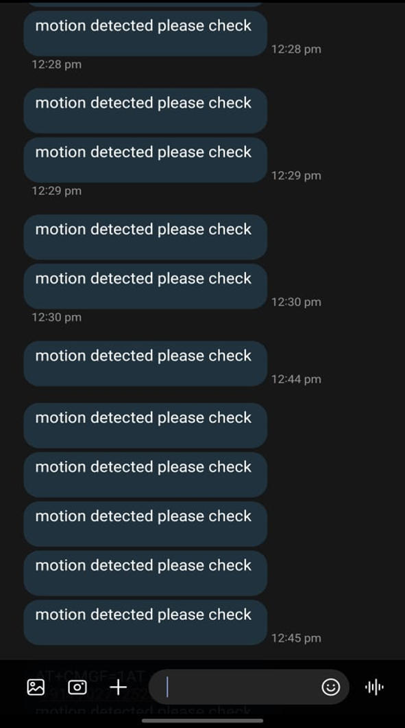

Slide 14
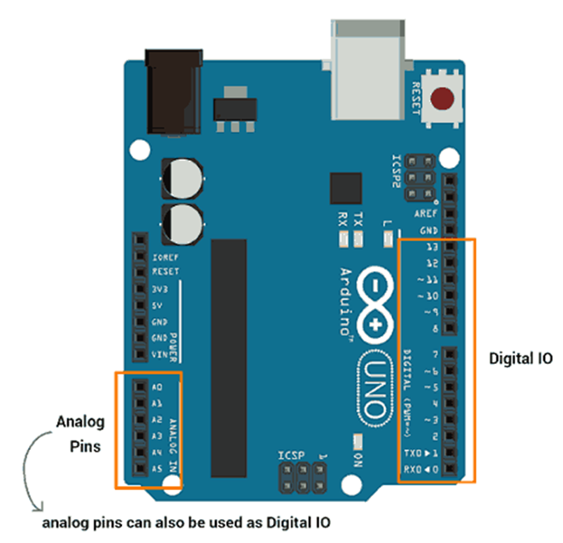
Arduino uno
Arduino is a single chip microcontroller
platform (open-source) that consists of a
circuit board Arduino IDE
(Integrated Development Environment)
It is used to write and upload the
computer code to the physical board.
It has 14 digital pins and
6 analog pins
input voltage limit : 6-20 V.
5 software power saving modes.
The Arduino programming languages
are C,C++,assembly language etc.

Slide 15
ADVANTAGES
Constant Protection – Employing the use of security guard services on site is challenging and expensive. This system can provide you with 24-hour protection against theft and break-ins at a fraction of the cost of a guard.
Strong Deterrent – When an intruder identifies that you have an alerting system at your location, they are often inclined to move on from your property. Even if they are unaware that a system exists on site, a siren or other auditory alarm typically drives them away.
Manage Remotely – This system is designed with mobility in mind. Using an app, you can manage, arm/disarm, and monitor your intrusion alarm system from anywhere.

Slide 16
FUTURE SCOPE
In the future, there will be very large scope, this project can be made based on Image processing in which an intruder can be detected by cameras and if it comes towards prohibited place then system will be directly activated through wireless networks.
Invaders can also be detected by using wireless networks such as laser wireless sensors and by sensing this laser or sensor’s security system will be activated.

Slide 17
CONCLUSION
The problem of security by invaders has become a major social problem in current time.
Thus this project carries a great social relevance as it aims to address this problem.
This project will help people in protecting their valuables and save them from significant financial losses.
Security you can trust
Detection you can depend on.

Slide 18
CODE
#include <SoftwareSerial.h>
SoftwareSerial SIM900(9,10);
String textForSMS;
int calibrationTime = 10;
int PIC_IN = 7;
int pir1=3;
int pir2=5;
int LED = 13;
int i;
int pirstate=LOW;
void setup()
{
Serial.begin(9600);
SIM900.begin(9600);
pinMode(LED,OUTPUT);
pinMode(PIC_IN, INPUT);
pinMode(PIC_IN, INPUT);
pinMode(pir1, INPUT);
pinMode(pir2, INPUT);
digitalWrite(LED, LOW);
Serial.println("calibrating sensor ");
for(int i = 0; i < calibrationTime;i++)

Slide 19
{
Serial.print(".");
delay(1000);
}
Serial.println(" done");
Serial.println("SENSOR ACTIVE");
delay(50);
}
void loop()
{
int val = digitalRead(PIC_IN);
int vab = digitalRead(pir1);
int vac = digitalRead(pir2);
if (val == HIGH)
{
digitalWrite(LED, HIGH);
textForSMS = "motion detected please check "; sendSMS(textForSMS);
if(pirstate==LOW)
{
Serial.println("motion detected");
Serial.println("message sent.");
pirstate=HIGH;
}
}

Slide 20
else if (vab == HIGH)
{
digitalWrite(LED, HIGH);
textForSMS = "motion detected please check ";
sendSMS(textForSMS);
);
if(pirstate==LOW)
{
Serial.println("motion detected");
Serial.println("message sent.");
pirstate=HIGH;
}
}
else if (vac == HIGH)
{
digitalWrite(LED, HIGH);
textForSMS = "motion detected please check ";
sendSMS(textForSMS);
if(pirstate==LOW){Serial.println("motion detected");
Serial.println("message sent.");
pirstate=HIGH;}
}

Slide 21
else
{
digitalWrite(LED, LOW);
if(pirstate==HIGH)
{
Serial.println("Motion not detected");
pirstate=LOW;
}
}
}
void sendSMS(String message)
{
SIM900.print("AT+CMGF=1\r");
messagedelay(1000);
SIM900.println("AT + CMGS = \"+919494576649\”);
delay(1000);
SIM900.println(message); // message to send
SIM900.println((char)26); // End AT command with a ^Z, ASCII code 26delay(1000);
SIM900.println(); // give module time to send SMS}

Slide 22
REFERENCES
https://bulldogfireandsecurity.com/how-intrusion-alarm-systems-work/
https://www.lawinsider.com/dictionary/intrusion-alarm
https://lastminuteengineers.com/pir-sensor-arduino-tutorial/

Slide 23
THANK YOU!

